Slide 1
Improving Credit Card Services NLP Analysis of Consumer Complaints
Jun Tian
February 2021

Slide 2
Problem:
Given consumer complaint narratives on credit card, how could financial companies respond to make consumers satisfied?

Slide 3
Data and Methodologies
Data source: Consumer Financial Protection Bureau (CFPB) managed a Consumer Complaint Database
Data Duration: December 1, 2011 to current
Methodologies
Data Wrangling
Exploratory Data Analysis
Natural Language Process
Machine Learning for Classification

Slide 4
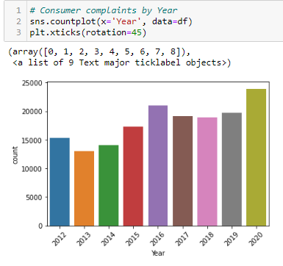

Slide 5
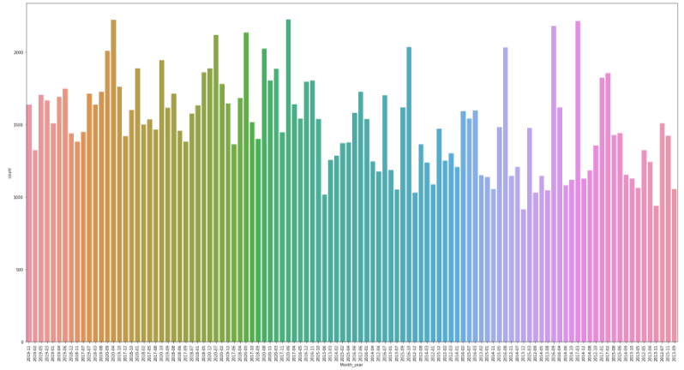

Slide 6
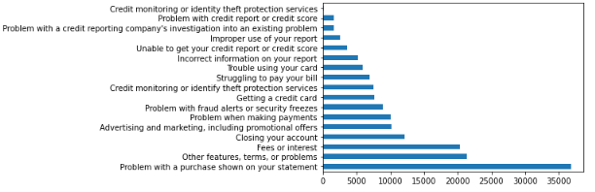

Slide 7
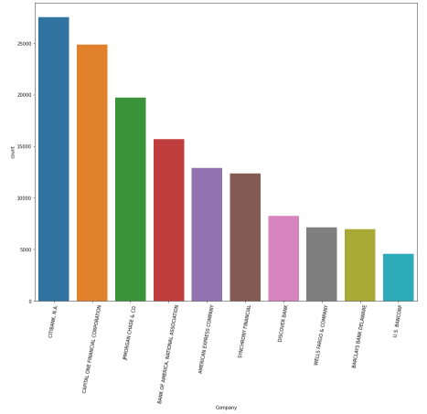

Slide 8
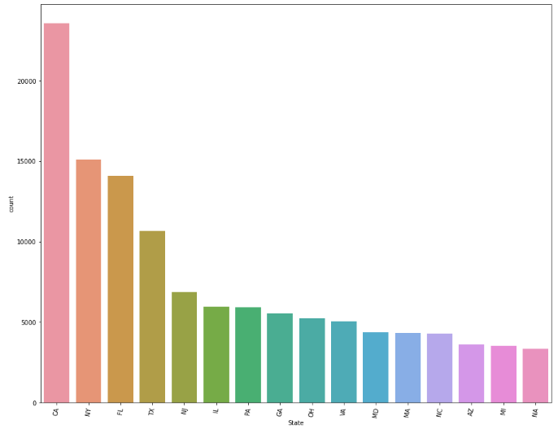

Slide 9
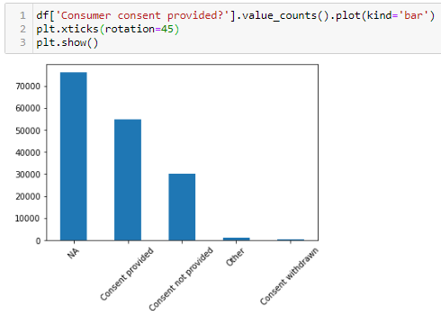

Slide 10
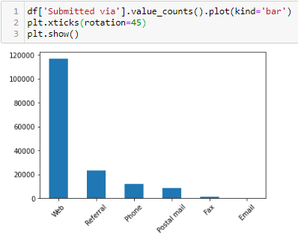

Slide 11
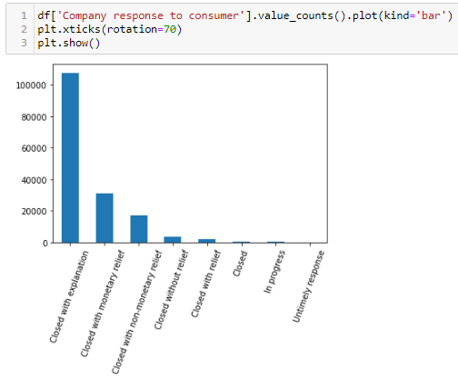

Slide 12
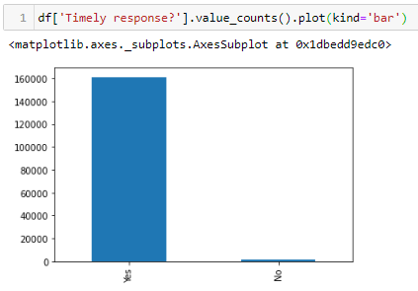

Slide 13
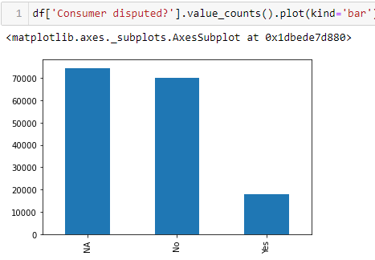

Slide 14
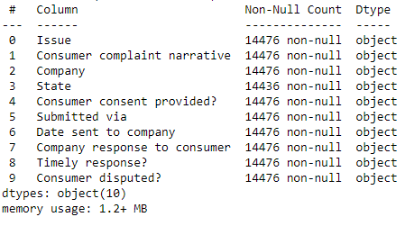


Slide 15
Natural Language Processing
Converting text data to lower case
Removing punctuations
Text standardization
Removing stopwords
Correcting spelling
Lemmatizing
Tf-idf vector representation

Slide 16

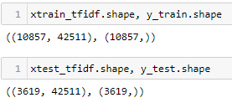
Multi-Classification with:
Logistic Regression
SVM
XGBoost

Slide 17
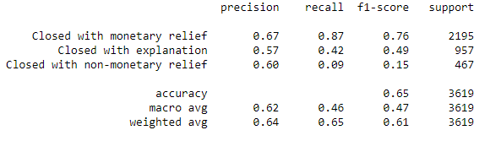
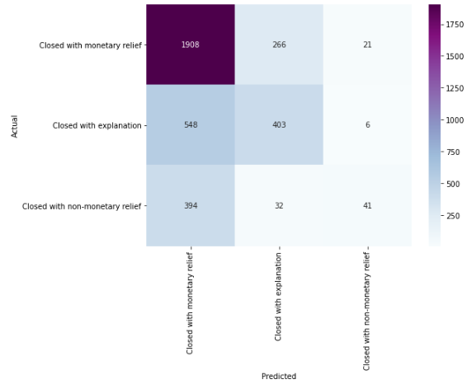
Logistic Regression

Slide 18
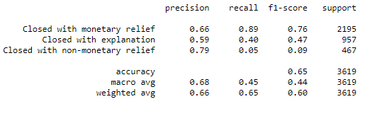
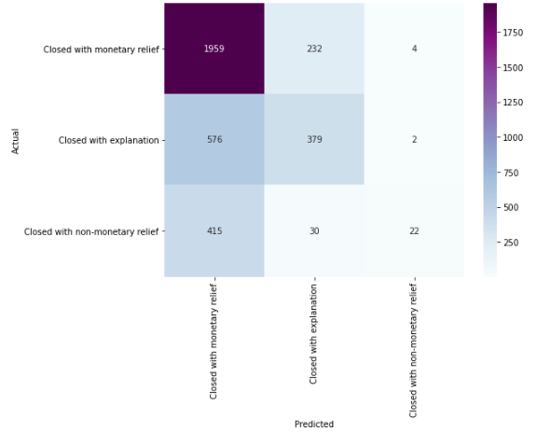
SVM

Slide 19
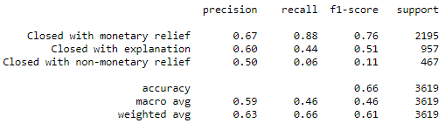
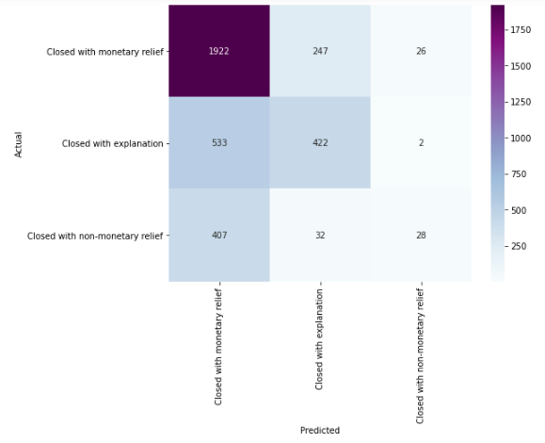
XGBoost

Slide 20
Findings and Recommendations
Our model provides a convenient and reliable way of classifying company responses, which can improve company effectiveness and save on human resources
Further improvement on modelling:
- Complete data information
- Using more recent data
- Combine with companies’ own database

